Slide 1
Machine Learning for Structured Data
Dr. Sifat Momen

Slide 2
Outline
Structured Data in Machine Learning
Supervised (Classification, Regression problems) and Unsupervised Learning
Machine learning Process
Performance metrics for classification problems
Hyper-parameter tuning
Explainable AI

Slide 3
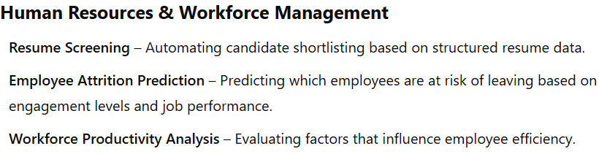
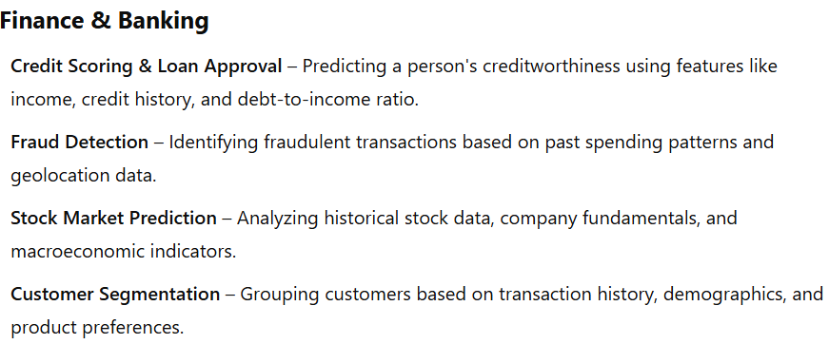
Do we use structured data (e.g. tabular data)?

Slide 4
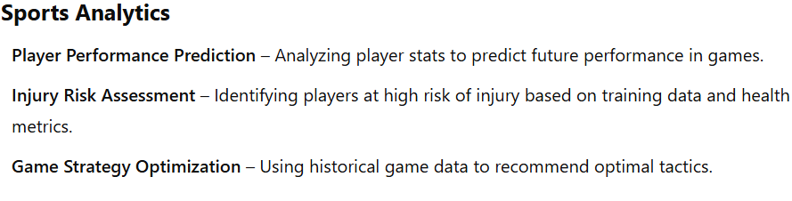
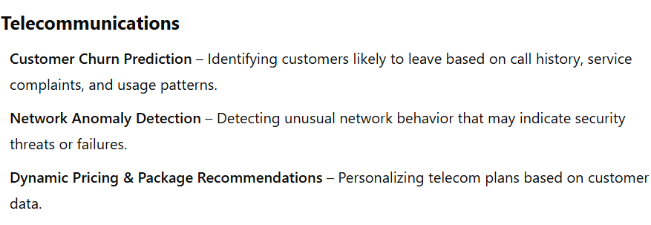
Do we use structured data (e.g. tabular data)?

Slide 5
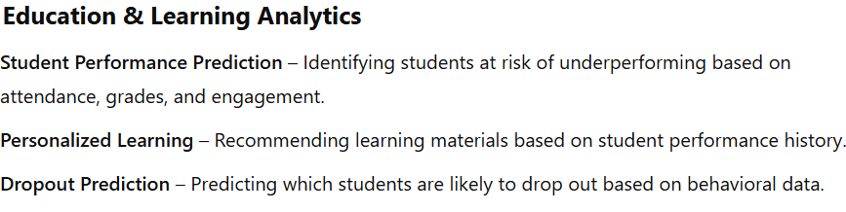
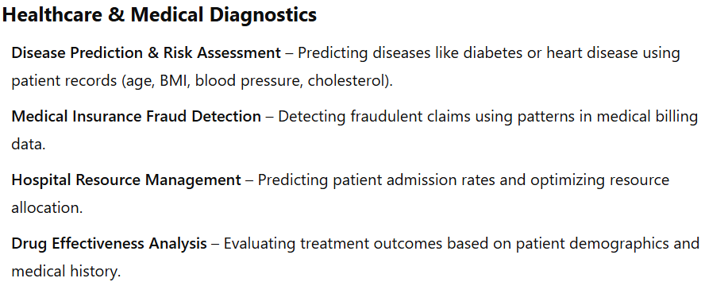
Do we use structured data (e.g. tabular data)?

Slide 6
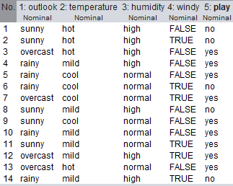
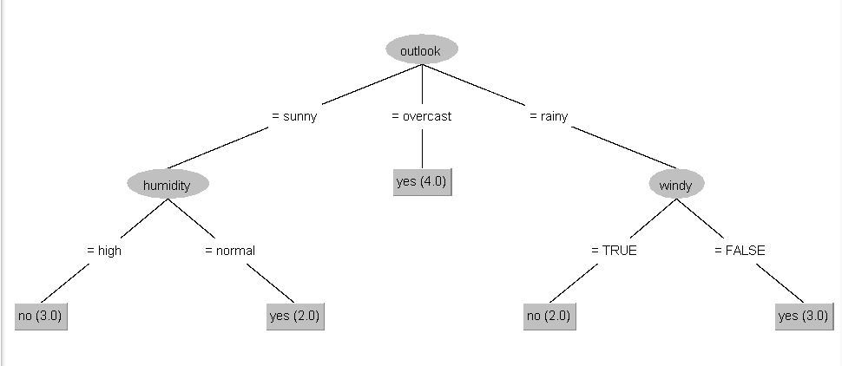
Supervised Learning
In supervised learning, the algorithm builds a mathematical model from a set of data that contains inputs and labels (desired outputs) <X, y>.
The data contains 14 instances and 4 attributes. The target variable is play
A Decision Tree Model

Slide 7
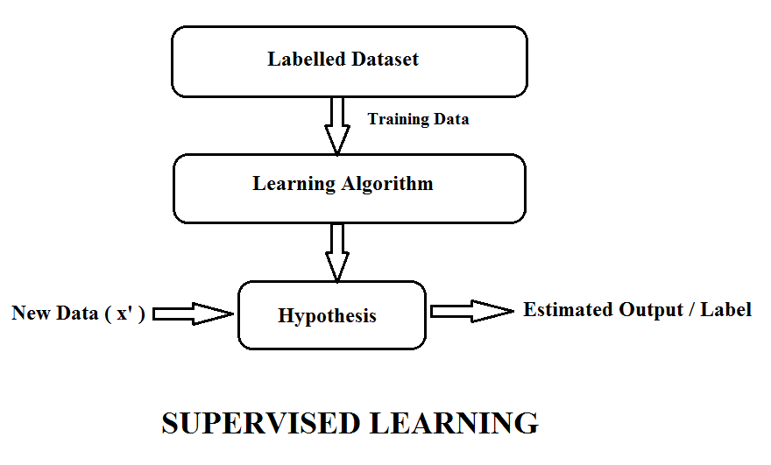
Supervised Learning

Slide 8
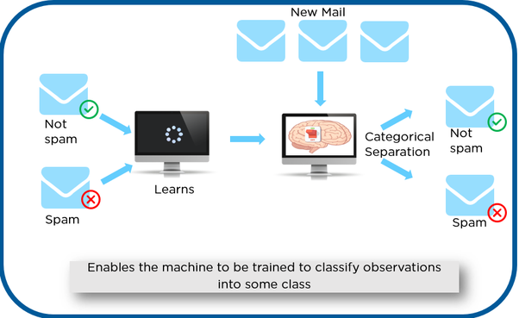
Supervised Learning - Classification

Slide 9
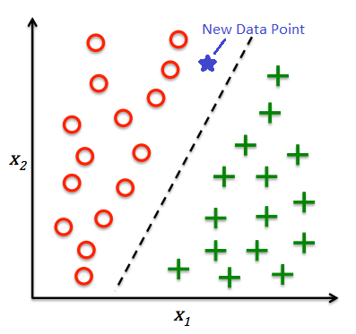
Supervised learning - Classification

Slide 10
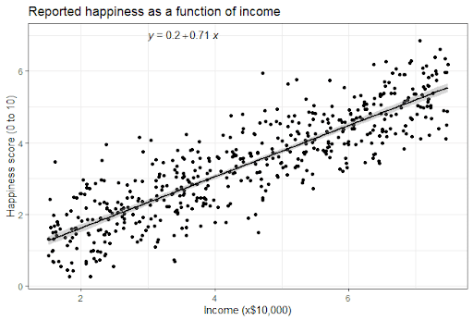
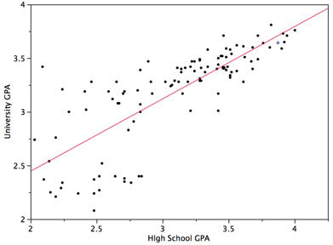
Regression

Slide 11
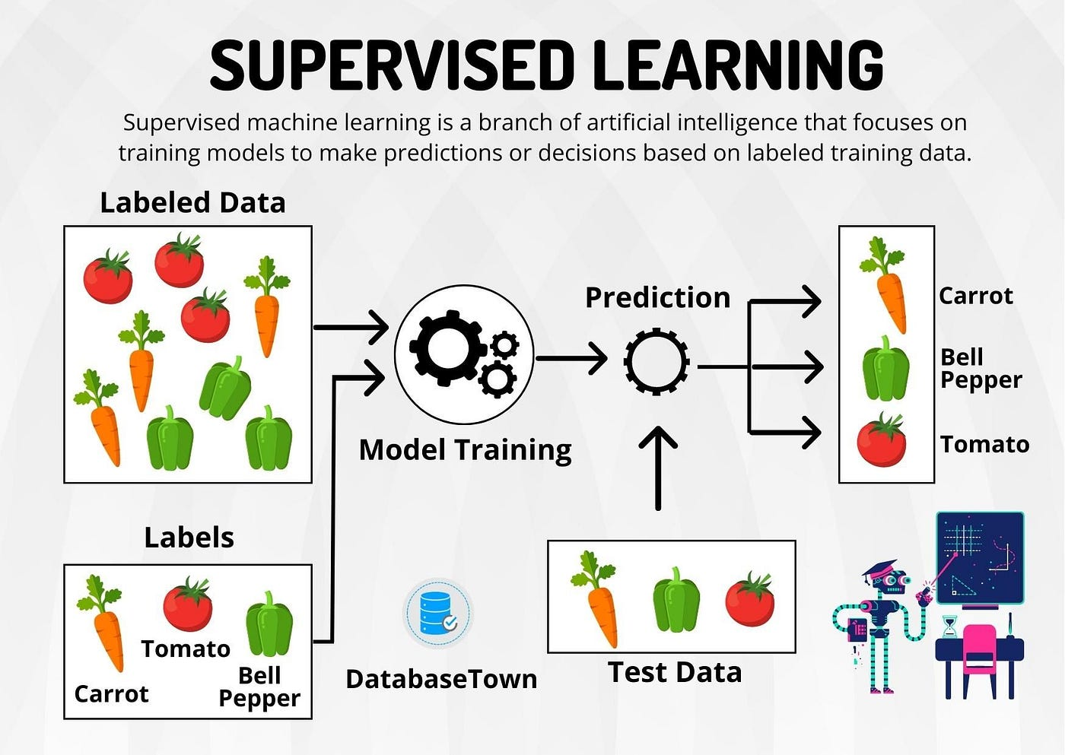

Slide 12
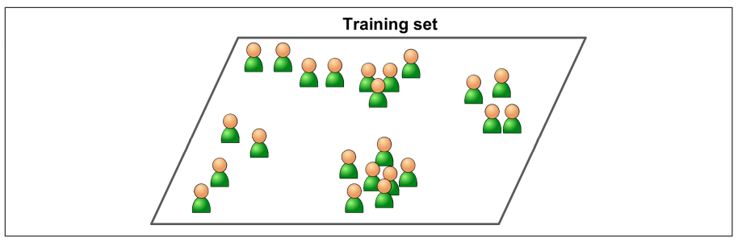
Unsupervised Learning
In Unsupervised Learning, the training data is unlabeled. The system tries to learn without a teacher.

Slide 13
Examples of Supervised Learning Algorithms
K-Nearest Neighbors
Linear Regression
Logistic Regression
Support Vector Machines
Decision Trees
Random Forests
Neural Networks
…

Slide 14
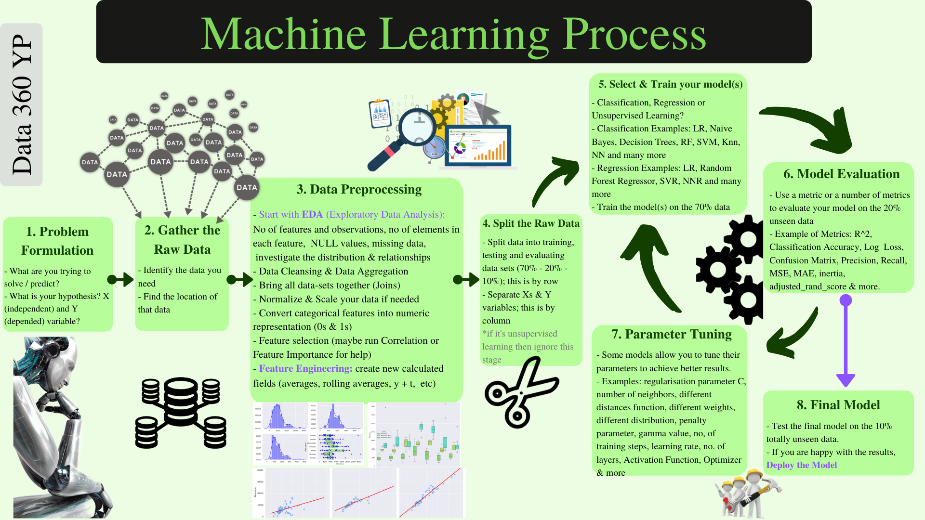

Slide 15
Confusion Matrix
 | PREDICTED CLASS
ACTUAL CLASS |  | Class=Yes | Class=No
 | Class=Yes | a (TP) | b (FN)
 | Class=No | c (FP) | d (TN)
Most widely-used metric:
FP is Type I error
FN is Type II error

Slide 16
Precision and Recall
When evaluating a search tool or a classifier, we are interested in at least two more performance measures:
Precision: Within a given set of positively-predicted results, the fraction that were true positives = TP/(TP + FP)
Recall: Given a set of positively-labeled results, the fraction of all positives that were retrieved = TP/(TP + FN)
Positively-labeled means judged “relevant” by the search engine or labeled as in the class by a classifier. TP = true positive, FP = false positive etc.

Slide 17
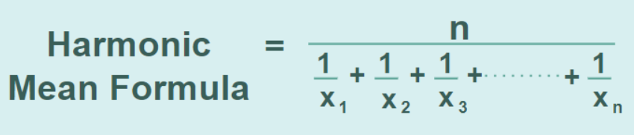
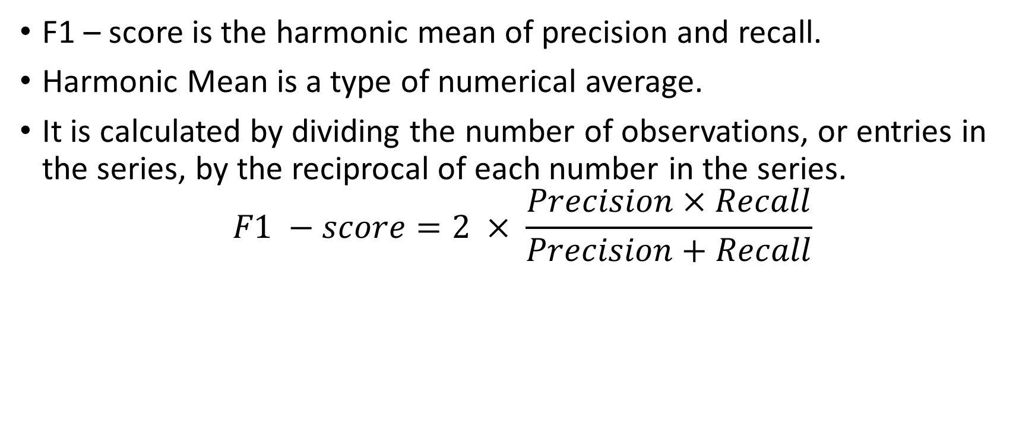
F1 – score
F1 – score is the harmonic mean of precision and recall.
Harmonic Mean is a type of numerical average.
It is calculated by dividing the number of observations, or entries in the series, by the reciprocal of each number in the series.
$$F1 −score=2 × \frac{Precision×Recall}{Precision+Recall}$$

Slide 18
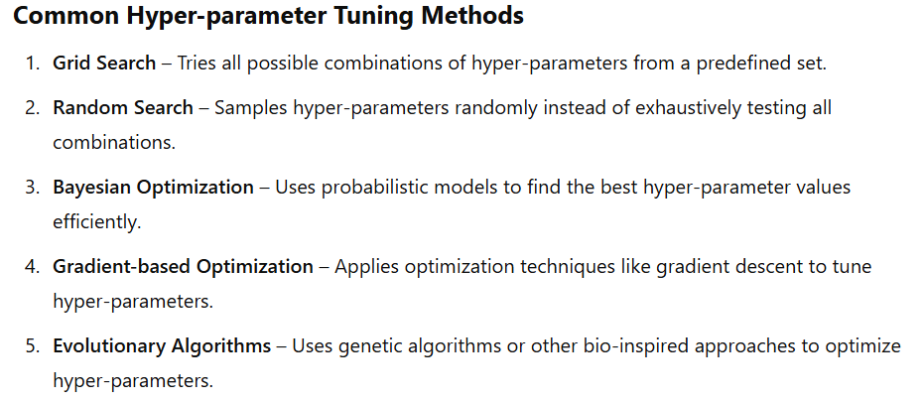
Hyper-parameter Optimization
Hyper-parameter tuning is the process of selecting the optimal set of hyper-parameters for a machine learning model to improve its performance.

Slide 19

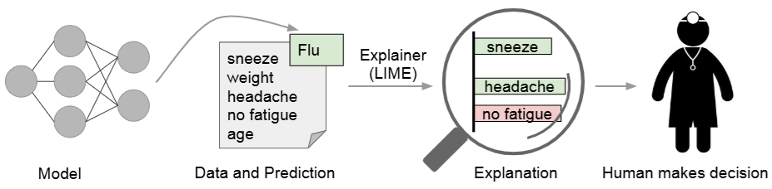
Explainable AI (XAI) – LIME (Local, Interpretable Model agnostic Explanation)
Two kinds of trust:
- Trusting a prediction
- Trusting a model

